Slide 1
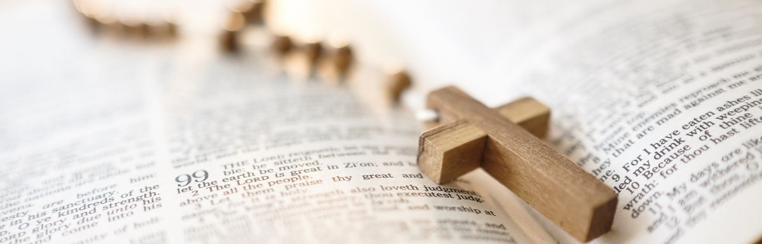
Scriptural Prayer
Kids Camp 2021

Slide 2

What is Scriptural Prayer?
When you use the prayers, psalms, and verses in the bible to help guide your own prayer.

Slide 3

Facts
There are 650 prayers in the bible.
The bible records Jesus praying 25 different times during His earthly ministry.
St. Paul mentions prayer 41 times in his epistles.
The book of psalms is a book of prayers that David wrote. There are 150 Psalms.

Slide 4
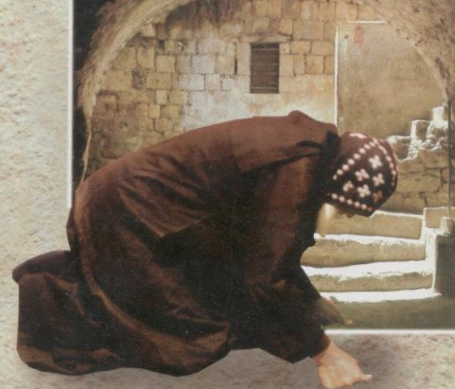
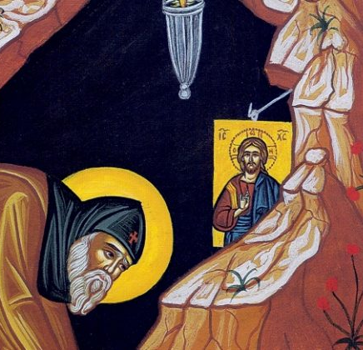
Postures while praying
The bible mentions different forms of postures while praying, examples include;
  Sitting (2 Sam 7:18)
  Standing (Mark 11:25)
  Kneeling (Chronicles 6:13; Daniel 6:10; Luke 22:41; Acts 7:60, 9:40, 20:36, 21:5; Ephesians 3:14), with one’s face to the ground,
    i.e. prostrations and metanias (Matthew 26:39; Mark 14:35), and with hands lifted up (1 Timothy 2:8), etc.

Slide 5
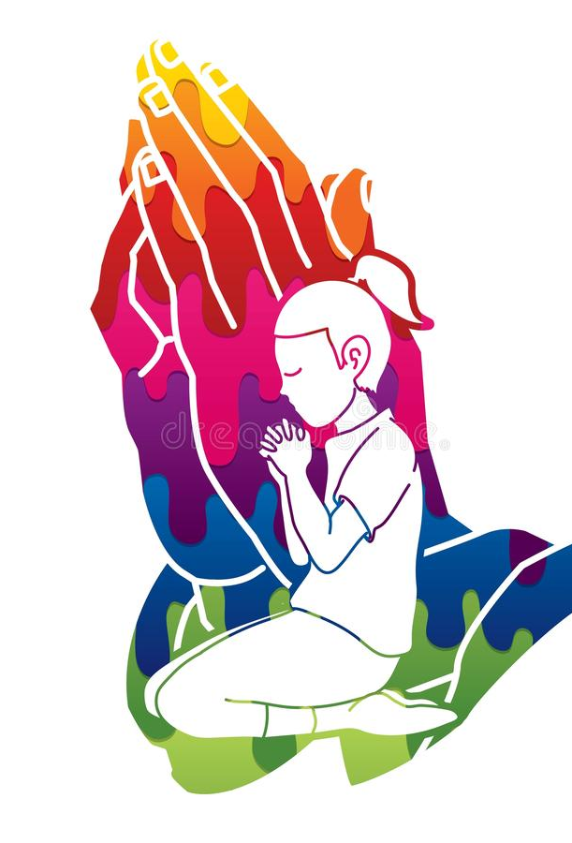
Main Types of Prayer
The Bible lists at least nine main types of prayer:
prayer of faith (James 5:15),
prayer of agreement (also known as corporate prayer) (Acts 2:42),
prayer of request (also known as petition or supplication) (Philippians 4:6),
prayer of thanksgiving (Psalm 95:2-3),
prayer of worship (Acts 13:2-3),
prayer of consecration (also known as dedication) (Matthew 26:39),
prayer of intercession (1 Timothy 2:1),
prayer of forgiveness (Luke 23:34)
and praying in the Spirit (1 Corinthians 14:14-15).

Slide 6
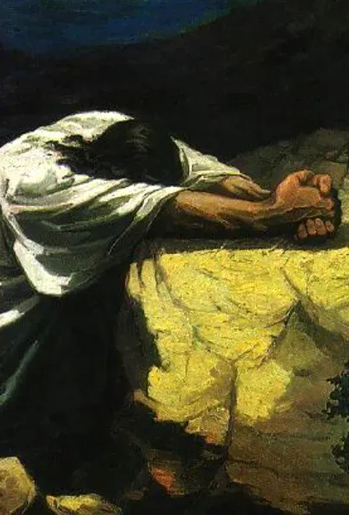
The Lord’s Prayer & Model for Prayer
In Jesus model for how His disciples should pray (Luke 11:1-4), He provides five areas of focus:
That God’s name be honored – the focus on his everlasting glory (“Our Father who art in Heaven, hallowed be thy name”);
that God’s kingdom come – the focus on his eternal will (“thy kingdom come”);
that God’s provision is given – the focus on our present (“Give us each day our daily bread.”);
that God’s forgiveness is granted – the focus on our past (Forgive us our trespasses/sins, for we also forgive everyone who trespasses/sins against us.);
that God’s deliverance will be provided – the focus on our future, (but deliver us from evil, in Christ, Jesus our Lord, for thine is the kingdom, the power and the glory forever and ever. Amen.)

Slide 7

The word
The word “Amen” (which means “let it be, “so be it,” “verily,” “truly”) makes its first appearance in the Bible in Numbers 5:22. In that passage God commands it to be said by a person who is praying as a justification.

Slide 8
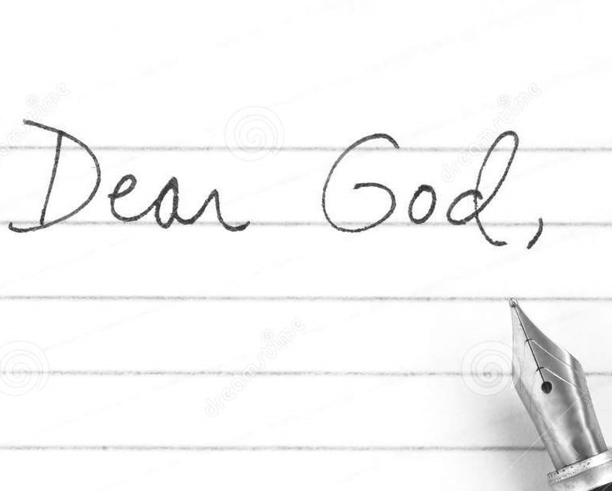
Activity: Dear God letter
Now it’s your turn to write a prayer
At the top of the letter draw a small cross sign and write “In the Name of the Father, the Son, and the Holy Spirit, One God. Amen.”
Start your prayer by addressing God – i.e. Our Father who art in Heaven, My Dearest Heavenly Father,, etc. show Him that you respect Him
For the body – look up a prayer from the book of psalms, understand what David is saying and use that understanding to inspire your prayer.
End your prayer with the word “AMEN”.

Slide 9

Your name goes here
Jesus Christ
Throne of God
New Jerusalem, Heaven
Paradise
PSALM ____

