Slide 1
God Chooses a Wife for Isaac

Slide 2
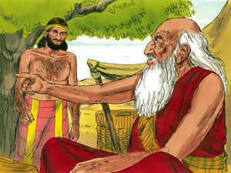
ABRAHAM
Abraham was a man of God
He wanted to choose a wife for his son, Isaac
Abraham called his servant, Eliezer and told him to go find a wife for Isaac

Slide 3
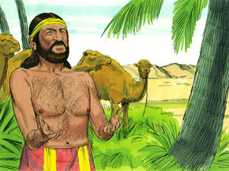
Eliezer
Eliezer prayed to the lord to guide him in his mission
He asked for God to show him the right girl by letting her give water to him and his camels

Slide 4
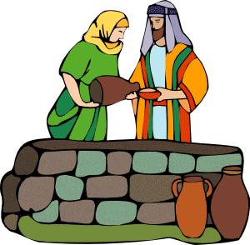
The Perfect Girl
Suddenly, He saw a beautiful girl
He asked her for water and she gave him and his camels
Eliezer knew that this was the perfect girl and thanked God

Slide 5
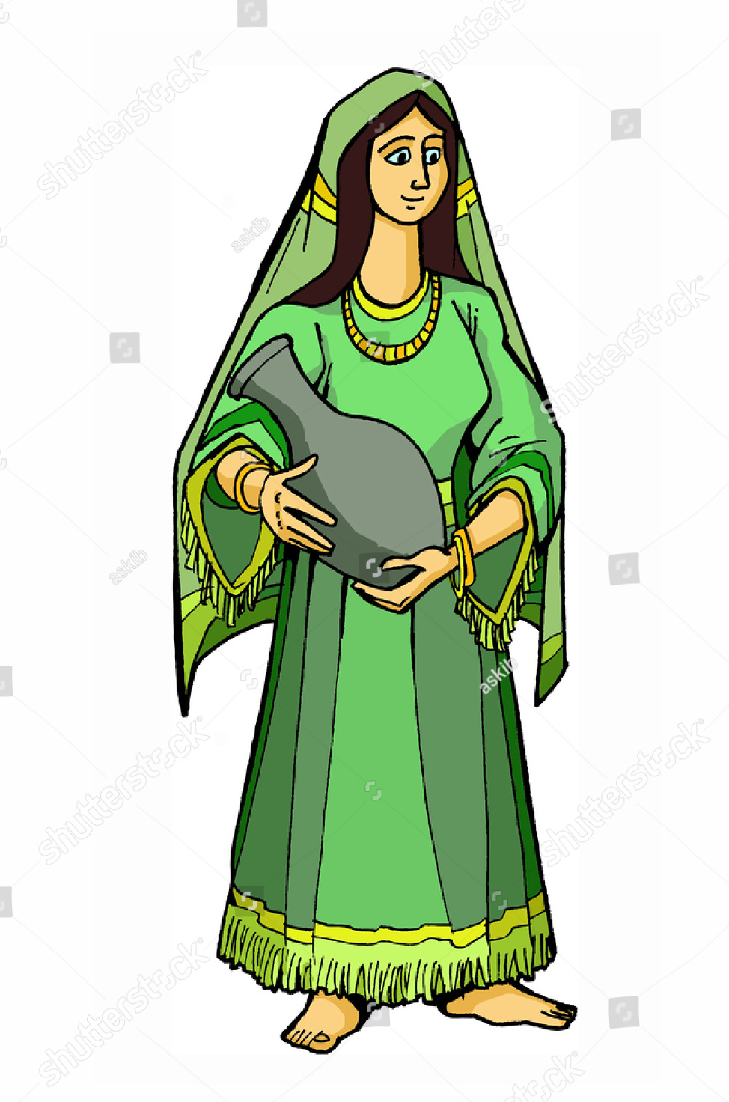
Rebecca
Eliezer asked her for her name and she said Rebecca
He went with her to her family and told him his story and about abraham and his son
He gave them gifts and asked if she could be Isaac’s wife
She and her family agreed

Slide 6

Rebecca and Isaac
She went back with Eliezer
As soon as Isaac saw her, he loved her and thanked the lord because he heard his fathers prayer
Then they got married

Slide 7
“Seek and you will find”
Verse
Luke 11:9

Slide 8
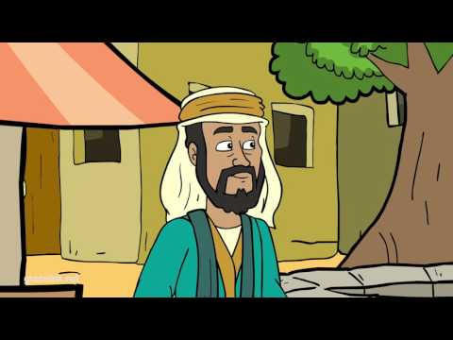
Video

Slide 9
Who is Isaac?
What was the name of the bride?
What did Eliezer ask God?
What did the girl offer?

